Slide 1

athenahealth - Identity Resolution
June 2025

Slide 2


Current State and Future Needs
Current Challenges
Desired Future State
Hosted, opaque model limits visibility and customization
Unable to independently troubleshoot matching issues
No easy way to validate or tune match logic
Intelligent system which leverages both deterministic + probabilistic matching approaches
Ability to set rules, review scores, and establish thresholds for match confidence levels (increased explainability)
Ability to democratize master customer IDs across athenahealth data ecosystem
Resolve anonymous users through identity vendor integrations

Slide 3
Popular Python Identity Matching Solutions
PACKAGE
APPROACH
Benefits
Fuzzy Matching:
FuzzyWuzzy, RapidFuzz
Well established string comparison libraries. Leverage Levenstein distance algorithm to determine the level of edits required to make two strings exact (provides fuzzy matching scoring)
Ability to associate specific columns of data containing human input (typos) or slight variations in formatting (address details)
Phonetic Match:
Soundex, Metaphone
Converts strings into phonetic keys which can be deterministically or fuzzy matched. Beneficial for variations in dialect, individual names, or misspelling of corporate names
Can be layered into fuzzy matching scoring to improve accuracy over certain PII fields
Increasing Complexity
Record Matching
Recordlinkage, Splink, Dedupe
Pre-built packages which contain functions for deterministic + fuzzy matching as well as AI/ML learning algorithms to improve matching overtime. Thresholds and rules can be established to determine matched pairs. Pre-approved matches can be used to train models which determine optimal threshold values across matching rules
Increase complexity introduces mature functionality to handle complex customer data landscape. Developed solutions are highly scalable and cloud-friendly
We can add a user story in a future sprint to rapidly prototype an in-house solution

Slide 4


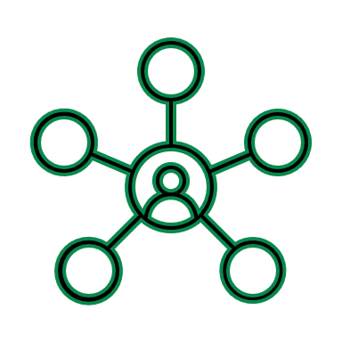
Questions to Explore
Master Data Management
What tool/vendor does athena use for Master Data Management?
Will “human-in-the-loop” capabilities (GUI-based manual review vs. programmatic matching) need to be developed to overwrite, update, or approve matches? What will the UI requirements be?
How is data preservation managed today? E.g., a matched pair has slightly differing address information
Data Availability
What personal identifies are available?
How does this data change across customer entities (e.g., campaign members, contact, leads, accounts)?
How is PII captured? Are there tools / techniques used to enrich the data today?
Data Consumption
What systems will the master IDs need to feed? (data and analytics, crm systems, customer facing solutions)
Is real-time resolution required or is batch sufficient?
4

Slide 5
Solution Options
OPTIONS
APPROACH
PROS
CONS
In-House Build (Python + Open Source)
Use open-source python packages to build a modular identity engine
Full control, transparent logic, configurable scoring, adaptable to data
Requires technical expertise, longer time-to-value, ongoing maintenance
Switch to a More Open/Scalable Vendor
Evaluate vendors like Axciom, Twilio Segment, and Treasure Data
Faster deployment, evaluation to ensure vendor meets new business requirements
Less customizable than in-house, may still involve vendor lock-in
Hybrid Agentic Architecture
Combine in-house orchestration + autonomous agents + vendor plugins (e.g. agents for stitching, tuning, QA)
Balanced control, scalable, AI-assisted troubleshooting and tuning
Emerging approach; depends on internal readiness and maturity
Build, Buy, or Blend (agentic hybrid) - each option has trade-offs across control, cost, complexity, and scalability
Increasing Task Complexity

Slide 6

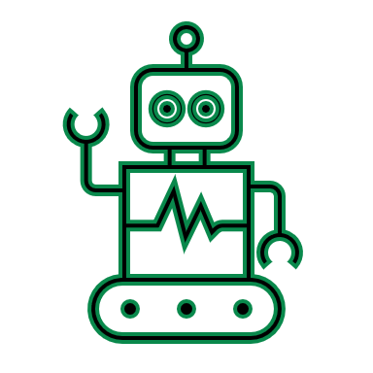
POV - How Agentic Architecture Can Help
Agentic AI in Identity Resolution
Treat each step (e.g., matching, deduplication, scoring, validation) as an autonomous agent with clear objectives.
Agents CAN
Suggest match rules or thresholds based on data patterns
Flag edge cases or ambiguous identities for review
Monitor confidence scores and trigger retraining or rule tuning
Explain “why” two identities were (or weren’t) matched
HOW IS IT DIFFERENT
Agentic AI Architecture
Traditional Python + Human Process
Agents run continuously, learning and optimizing autonomously
Humans manually code, test, and iterate match logic
Modular agents specialize in tasks (e.g., scoring, stitching)
Monolithic scripts or notebooks handle full pipeline
Feedback loops are embedded, triggering retraining dynamically
Retraining is manual and episodic (e.g., quarterly)
Agents explain their match rationale and flag edge cases
Explanations rely on code audits or rule comments

Slide 7



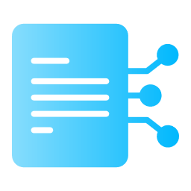

Agentic Partner Experience
Reviews low-confidence matches and validates ambiguous records
Helps refine scoring logic and rules over time
Participates in governance and compliance tracking
Knowledge Base Generation Agent
Multi-Agent Orchestration
Customer Data Platform
Salesforce
Website
External Sources
Deterministic and Probabilistic Scoring Agent
Identity Resolution and Activation Agent
Monitoring and Feedback Agent

Slide 8
Appendix

Slide 9
Python-Based Identity Matching Solutions – At a Glance
PACKAGE
APPROACH
STRENGTHS
LIMITATIONS
Splink
Probabilistic (EM algorithm), Spark-native
Scalable, interpretable, used in government ID projects
Requires feature engineering
Magellan
Workflow-based ML + rule-based
Comprehensive, academic backing
Not actively maintained
Dedupe.io/ dedupe
Active learning + Python API
Simple setup, good for small to mid-size datasets
Limited scalability
RecordLinkage
Rules + ML + GUI
Easy to prototype, pandas-friendly
Not cloud-native or production-ready
Recommendation: Start with Splink for balance of flexibility, scale, and maturity

Slide 10

Questions to Explore
Data and Infrastructure
Current System Usage
What types of identifiers are available? (cookies, IP, device ID, hashed PII, etc.)
How is ActionIQ currently set up (e.g., rules vs ML)?
How frequently is this data updated?
Can we access historical matches and error cases?
How many sources/systems does it need to stitch across?
Is any audit or scoring metadata available?
Business Goals
What is the primary use case? (personalization, attribution, CDP enrichment?)
Is real-time resolution required, or is batch sufficient?
How important is explainability vs automation?
Constraints
What is the current internal technical maturity to support a custom or hybrid build?
Are there vendor or cloud partner preferences?
10

